Slide 1
Sequence to Sequence Model

Slide 2
Syllabus
Sequence to Sequence Model Overview
Encoder-Decoder
Attention Mechanism

Slide 3
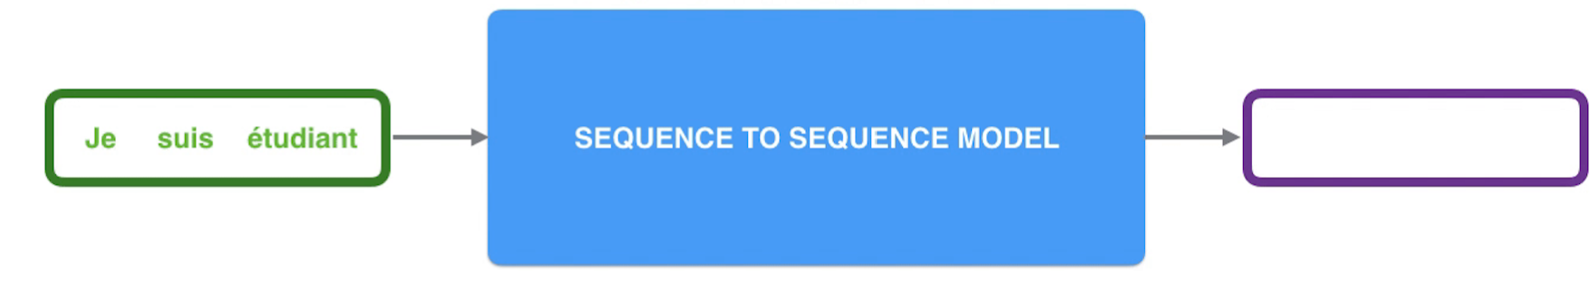
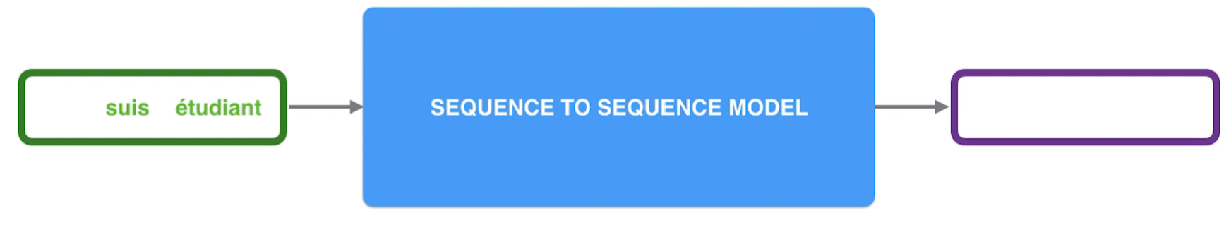
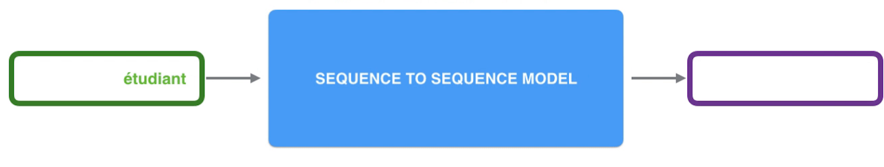

Sequence to Sequence Model Overview
Sequence and Sequence model is an interesting NLP model that can do mapping between input text and output
text. Specifically, the input can be a sequence of text (source language).

Slide 4

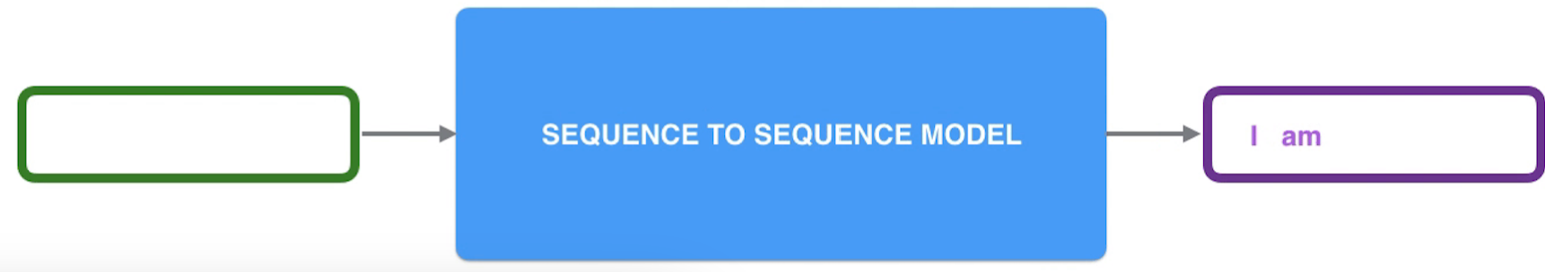
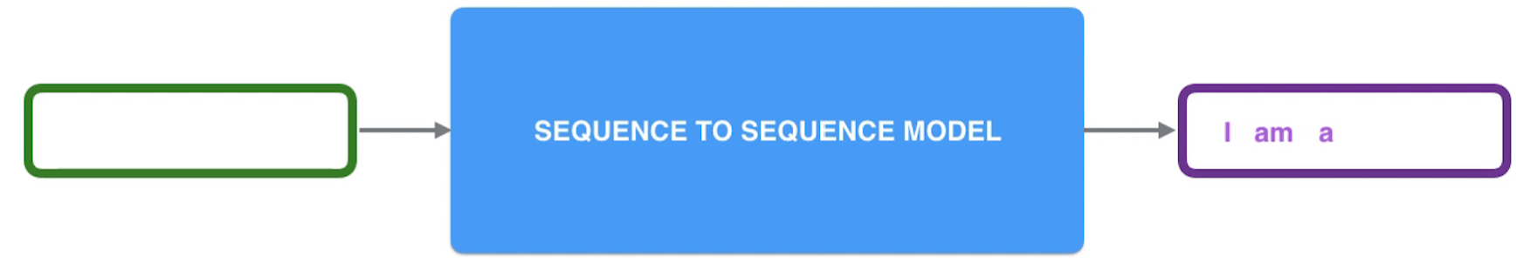
Sequence to Sequence Model Overview
The output is also a sequence of text (target language) in machine translation use case.
Student

Slide 5
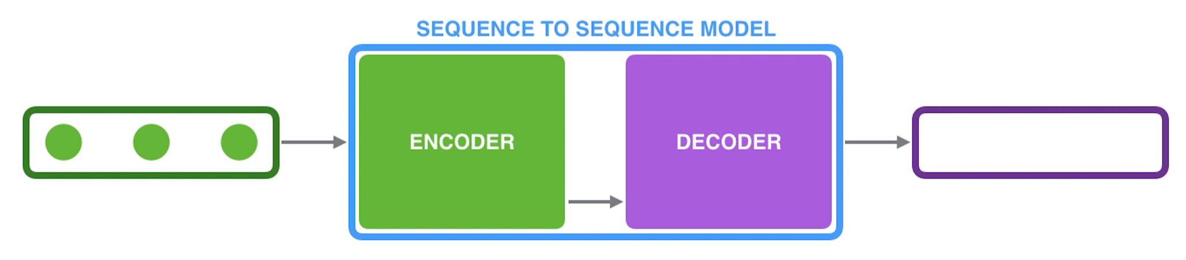


Sequence to Sequence Model Structure: Encoder-Decoder
Encoder: Handles each element of text sequence (a word) can transform them into Context Vector
Decoder: Generates output text sequence based on Context Vector
Je suis un étudiant
I am a student

Slide 6
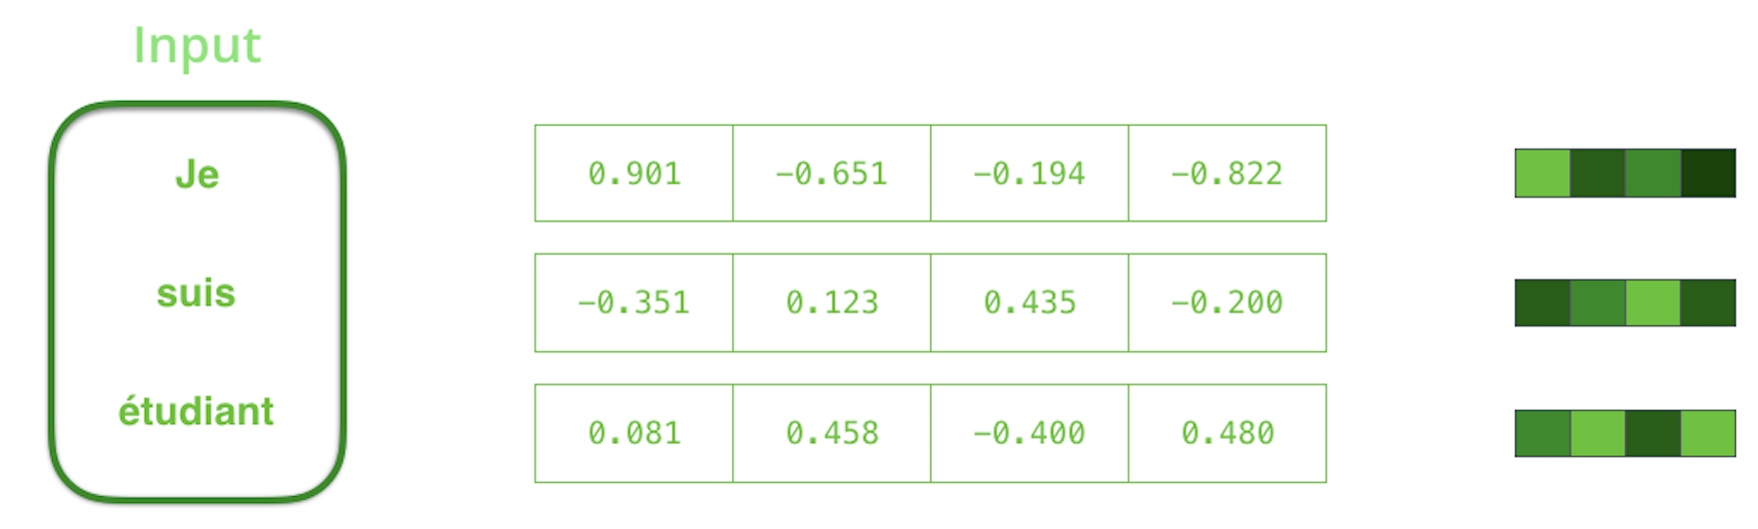
Input: Word Embedding
Word Embedding: Normally, the input text sequence is encoded as a dense vector

Slide 7
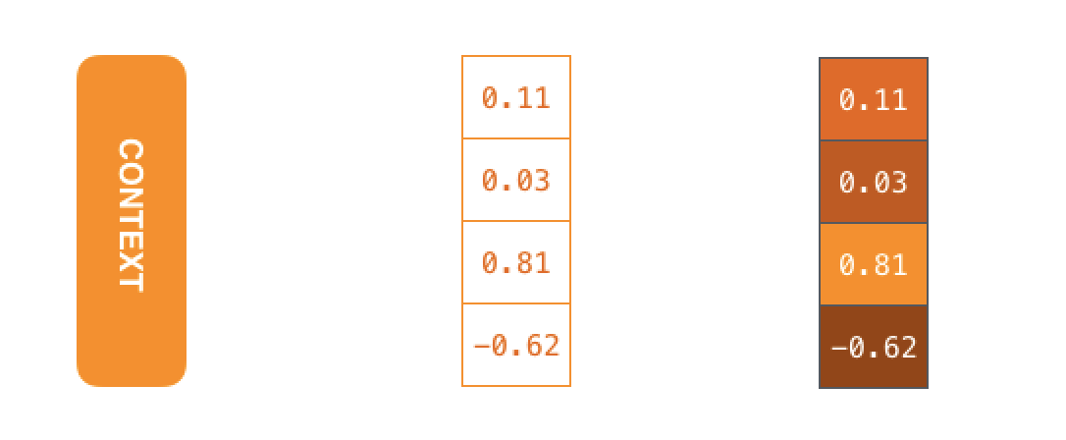
Context Vector
Context Vector: Generated by Encoder and will be feed into Decoder

Slide 8
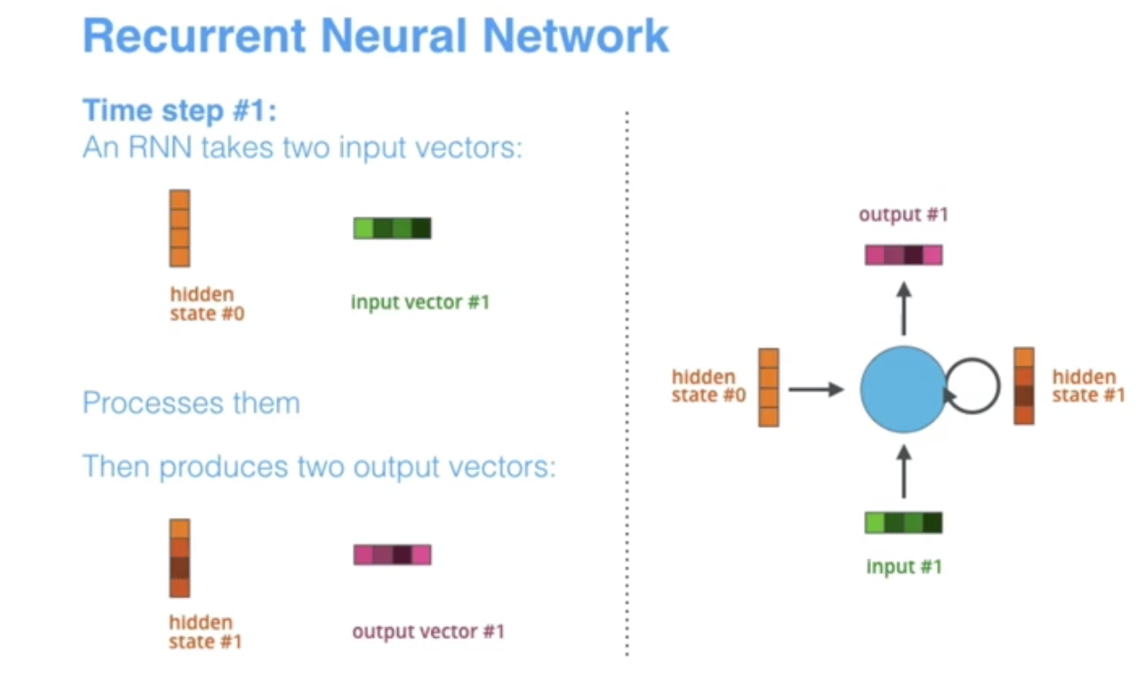
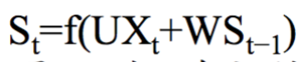
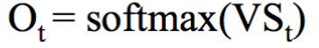
Implementation of Encoder and Decoder: Recurrent Neural Network
Recurrent Neural Network: The input vector of each timestamp will be processed with the previous hidden
state and then generate the corresponding hidden state and output.

Slide 9
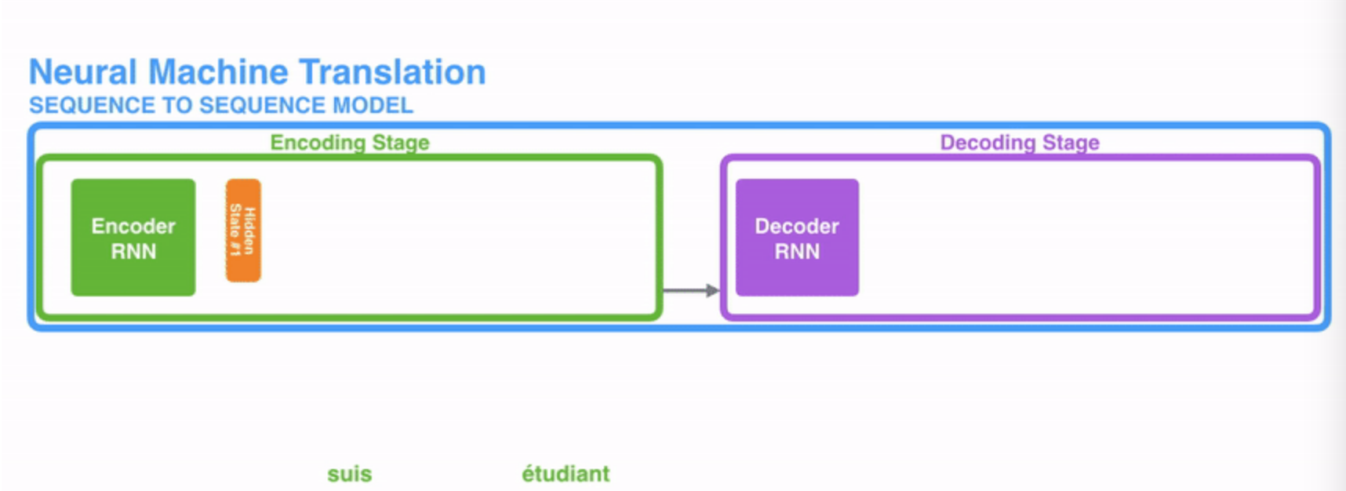
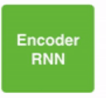
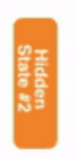
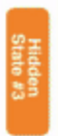
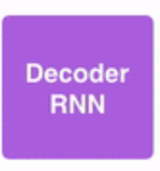
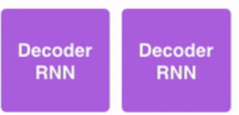
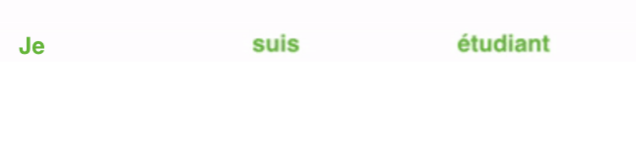
RNN in Encoder and Decoder
I am a student
Je

Slide 10
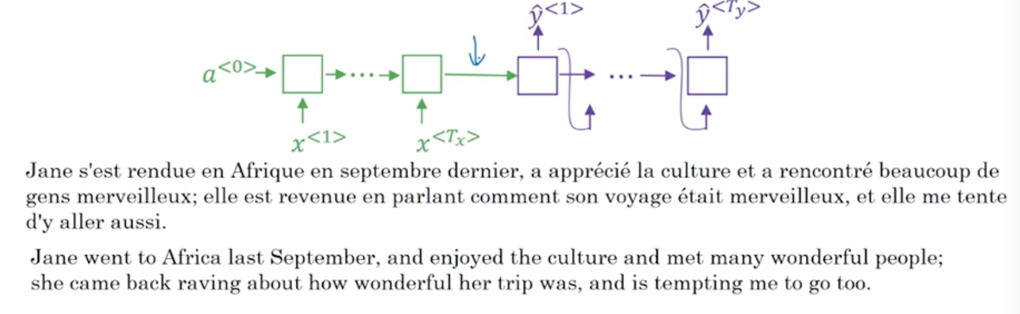
Problems of long sequences

Slide 11

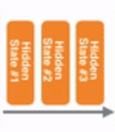
Solution: Attention in Encoder and Decoder
To learn the alignment between the source language and the targeted language, Attention is applied in Sequence
and Sequence model instead of using the context information that is put into a single context vector.
I am a student
Je

Slide 12
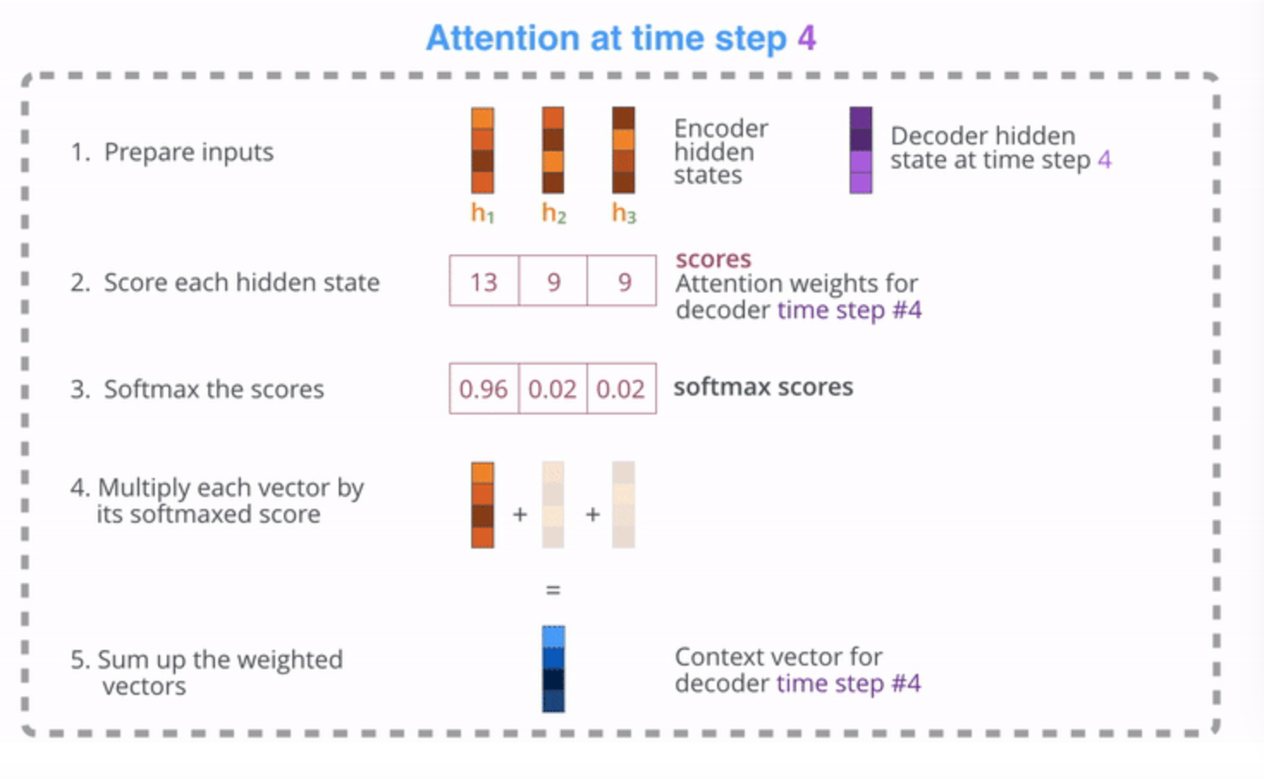
Attention Mechanism
Attention mechanism can be understood as a weighted approach(softmax) based on the importance of input.
Specifically, it sets different weights for the hidden states generated by Encoder.

Slide 13
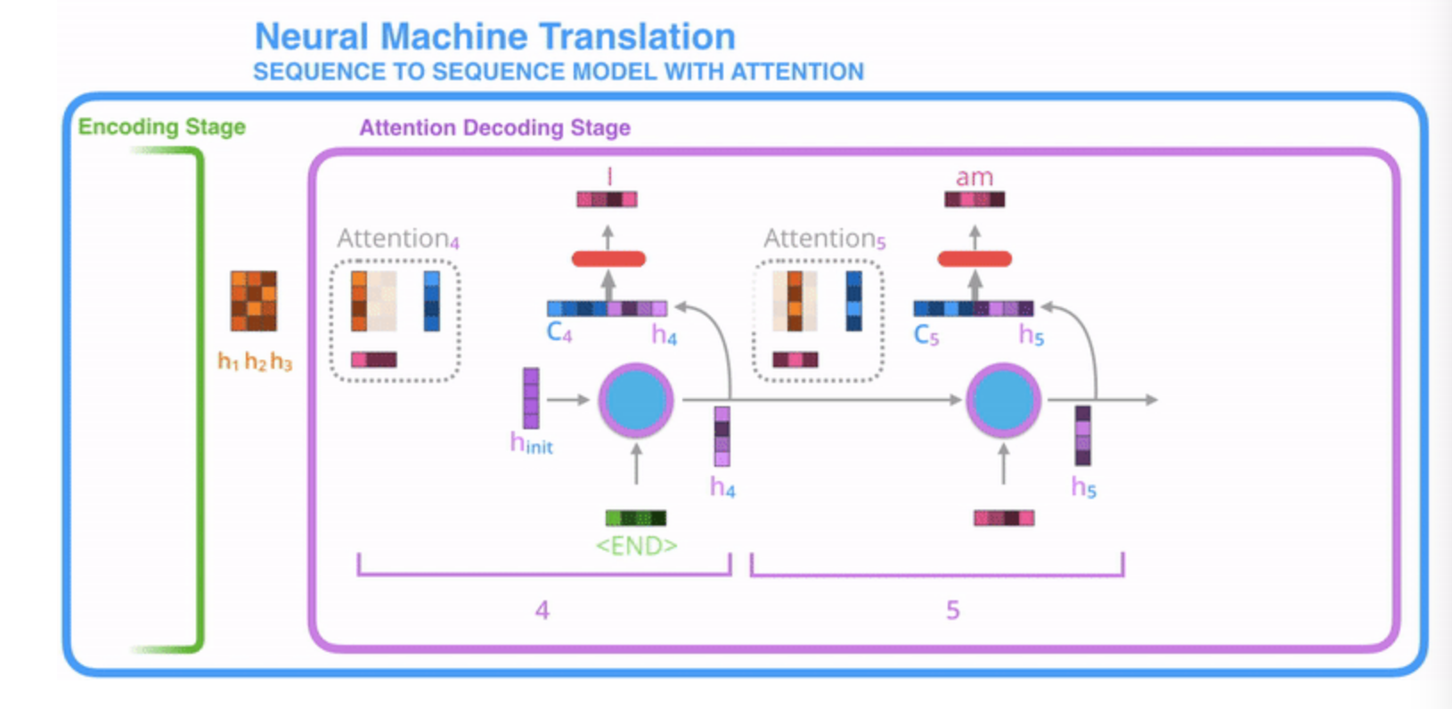
Attention Mechanism
1. RNN Decoder with attention receives word embedding and a init hidden state as input.
2. RNN cell handles input, generates output(discard) and a new hidden state (h4).
3. Then attention mechanism is applied to calculate context vector (c4) using Encoder’s hidden states and
the new hidden state(h4).
4. Concatenates context vector(c4) with the new hidden state (h4).
5. Finished decoder step with the concatenated vector as input using fully connected layer (softmax).
6. Repeats the above steps for each RNN cell

Slide 14
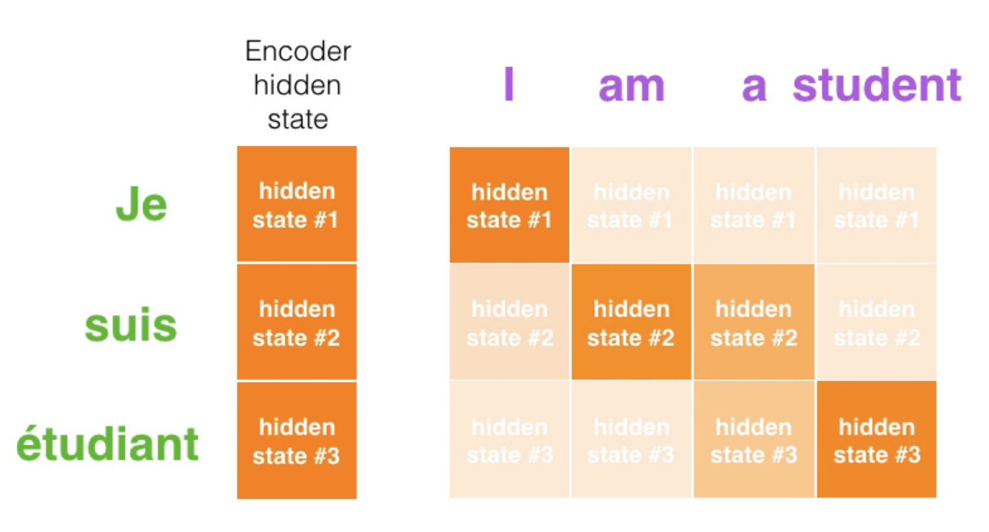
Attention Mechanism

Slide 15
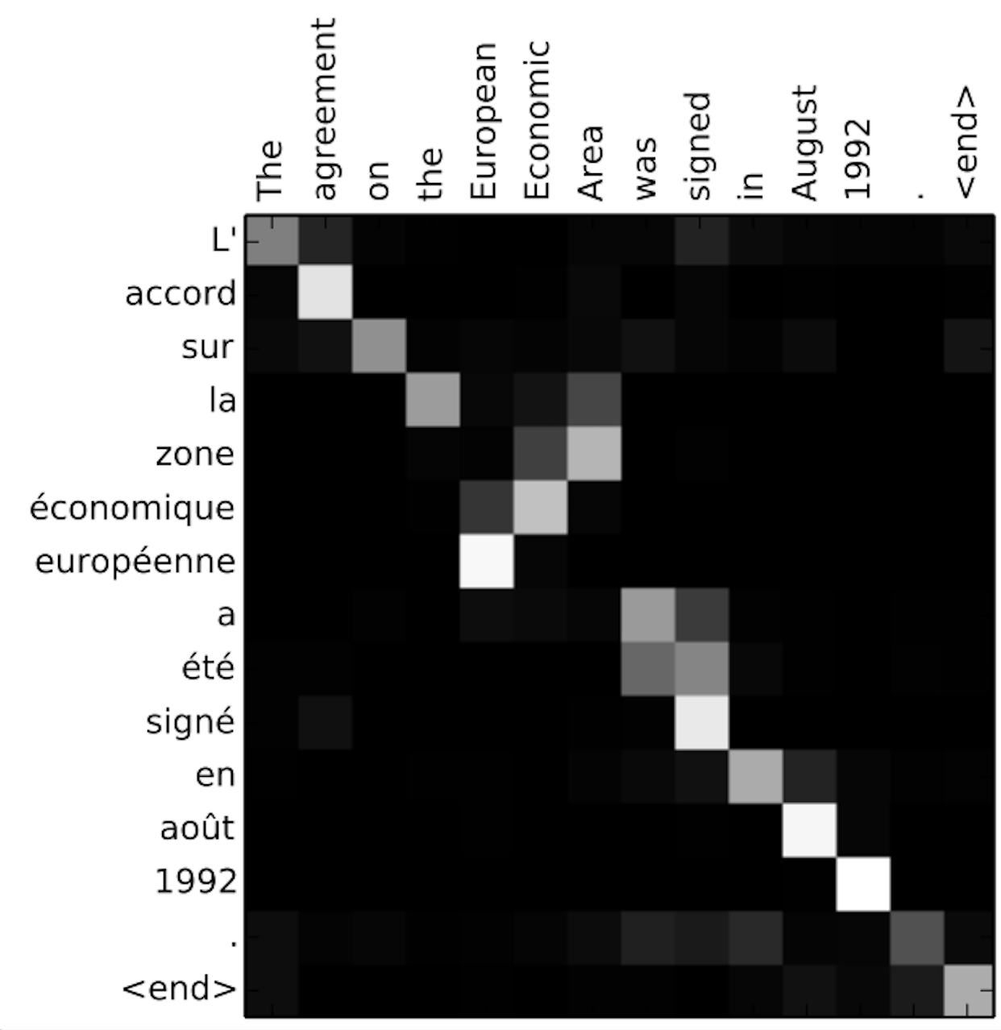
Attention Mechanism
Attention mechanism can used to learn the alignment between the source language and the targeted language.

Slide 16
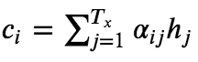
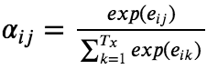
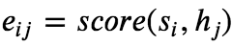
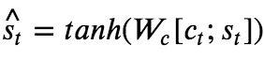
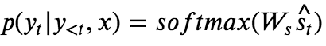
Attention Mechanism Details
Input： 𝑥=(𝑥1,...,𝑥𝑇𝑥)
Output： 𝑦=(𝑦1,...,𝑦𝑇𝑦)
(1) ℎ𝑡=𝑅𝑁𝑁𝑒𝑛𝑐(𝑥𝑡,ℎ𝑡−1): each RNN cell in Encoder receives word embedding of each input word and the
hidden state generated by the previous cell. The output is the hidden state of this current cell.
(2) 𝑠𝑡=𝑅𝑁𝑁𝑑𝑒𝑐(𝑦𝑡−1^,𝑠𝑡−1): each RNN cell in Decoder receives word embedding of each targeted word
and the hidden state generated by the previous cell.
(3) , : Context vector is a weighted average of hidden states generated by Encoder.
(4) : The weight of each hidden state generated by Encoder.
(5) : The score is calculated by hidden states generated by both Encoder and Decoder.
It is used for the weight calculation in step (4).
(6) ：Concatenates context vector with the hidden state generated by Decoder.
(7) ：Calculates the final output probability of each word in dictionary.

Slide 17
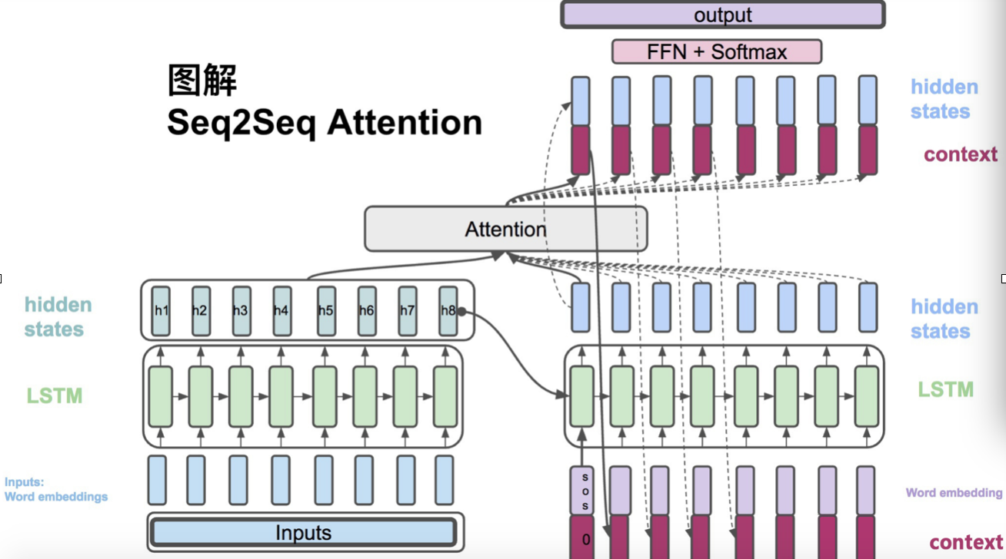
Attention Mechanism Details

Slide 18
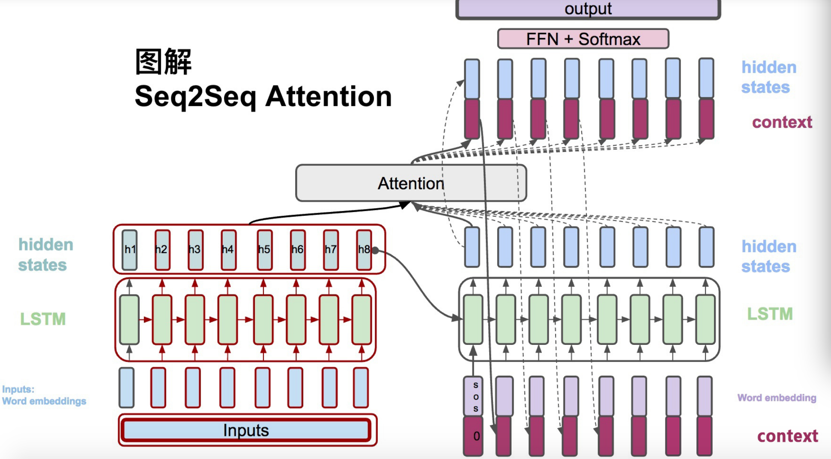
Attention Mechanism Details
1) ℎ𝑡=𝑅𝑁𝑁𝑒𝑛𝑐(𝑥𝑡,ℎ𝑡−1): each RNN cell in Encoder receives word embedding of each input word and the
hidden state generated by the previous cell. The output is the hidden state of this current cell.

Slide 19
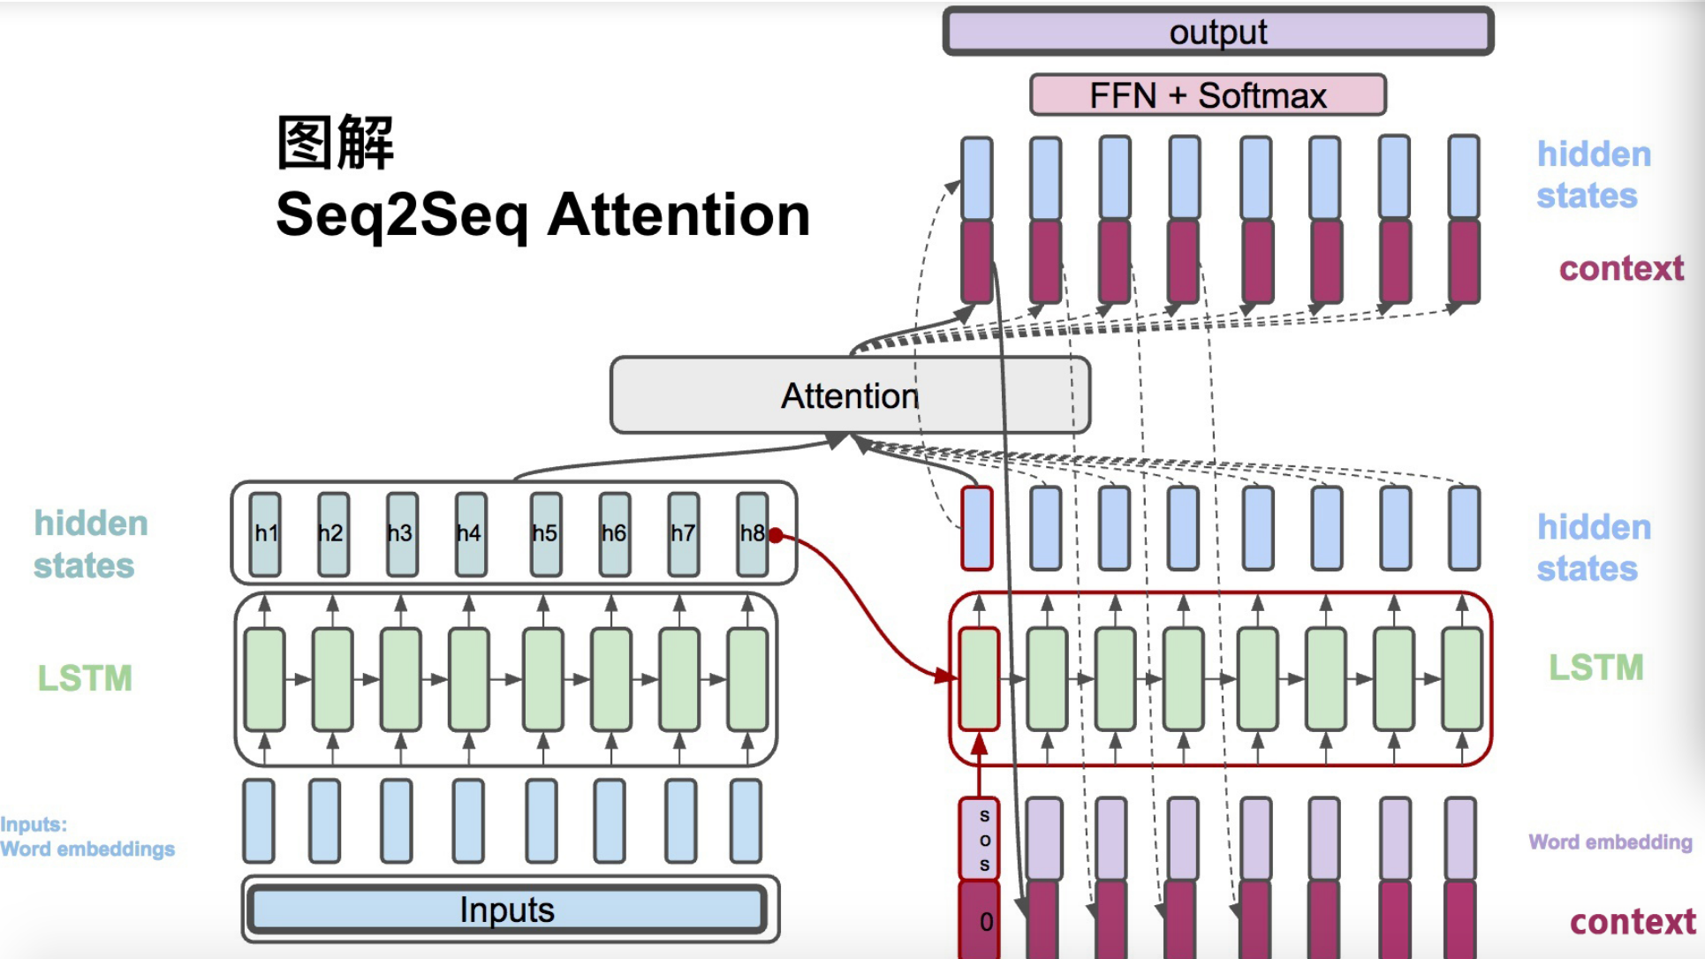
Attention Mechanism Details
(2) 𝑠𝑡=𝑅𝑁𝑁𝑑𝑒𝑐(𝑦𝑡−1^,𝑠𝑡−1): each RNN cell in Decoder receives word embedding of each targeted word and the
hidden state generated by the previous cell.

Slide 20
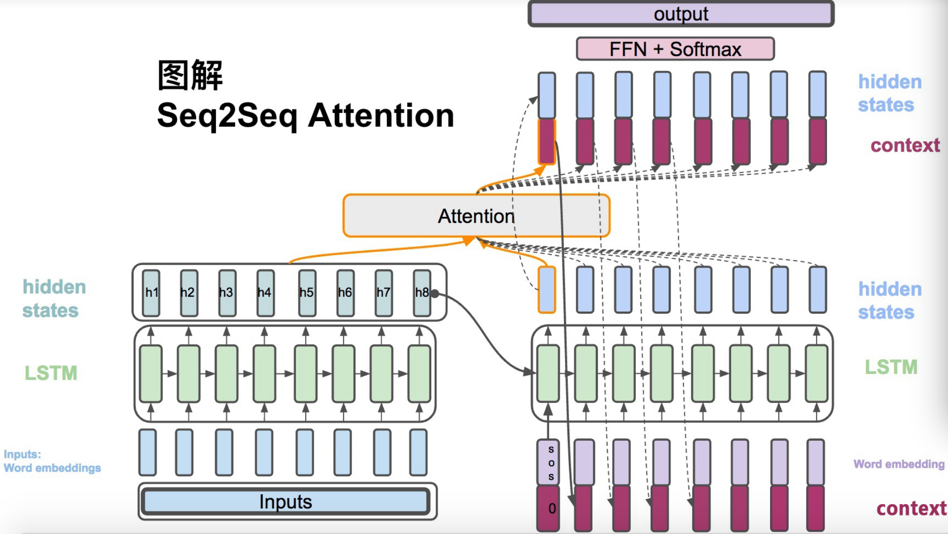
Attention Mechanism Details
(3) , : Context vector is a weighted average of hidden states generated by Encoder.
(4) : The weight of each hidden state generated by Encoder.
(5) :: The score is calculated by hidden states generated by both Encoder and Decoder.
It is used for the weight calculation in step (4).

Slide 21
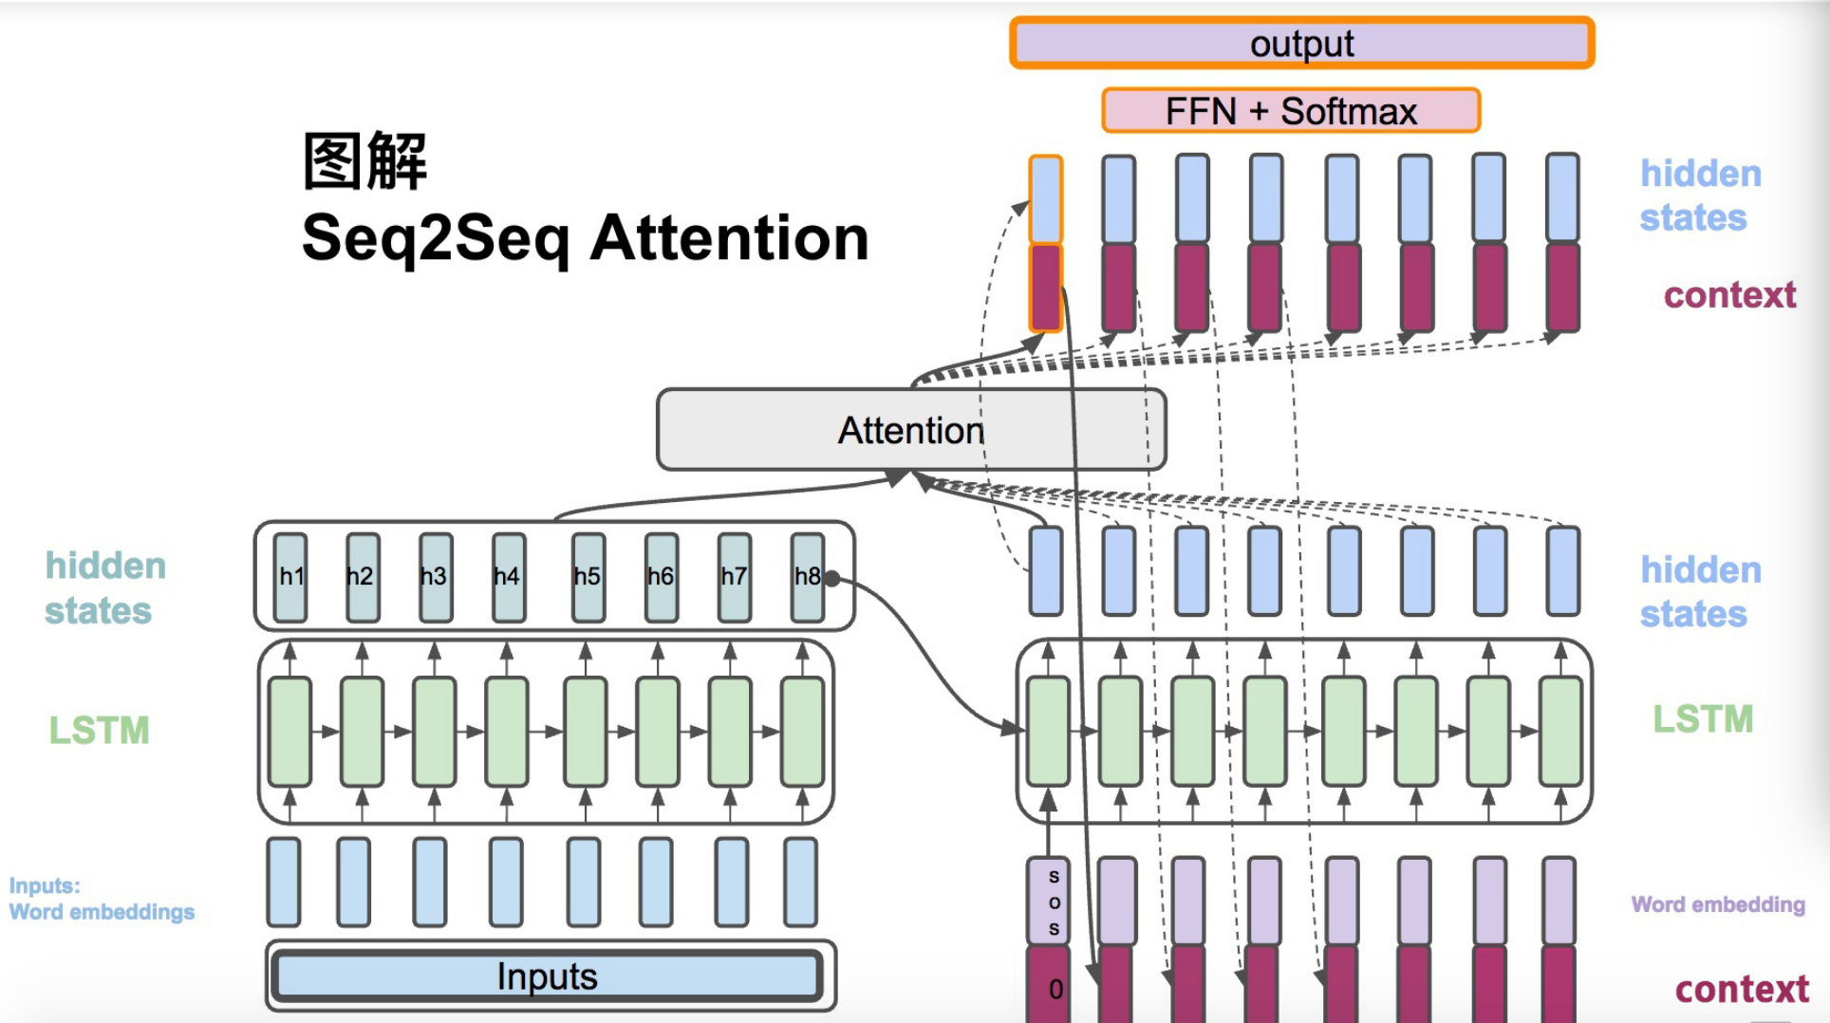
Attention Mechanism Details
(6) , : Concatenates context vector with the hidden state generated by Decoder.
(7) : Calculates the final output probability of each word in dictionary.

Slide 22
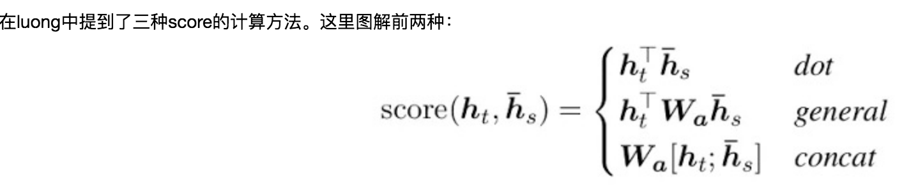
Attention Mechanism: Score Calculation
Three approaches to calculate score

Slide 23
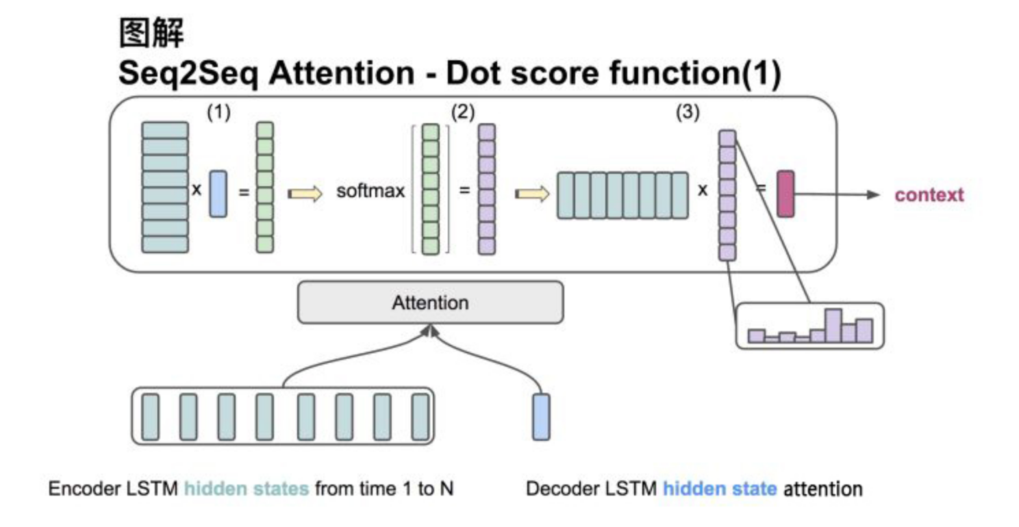
Attention Mechanism: Score Calculation
Approach 1
Input: The dimension of matrix represents all hidden states generated by Encoder (H):
(hidden dimension, input sequence length)
The dimension of hidden state generated by decoder at any time point (S):
(hidden dimension, 1)
1) Get score matrix (sequence length, 1) by transposing H to (sequence length, hidden dimension) and conducting
dot with S
2) Applying softmax to these scores to normalize the sum of weighted scores = 1
3) Generating Context Vector by conducting Dot to H and the weighted scores of step (2)

Slide 24
Sequence to Sequence Model Use Cases
Chatbot
Machine Translation (Github: https://github.com/tensorflow/nmt)
Auto Summarization

